Slide 1
TMS原理與介紹
Basics
MP-Family
Hands-on

Slide 2
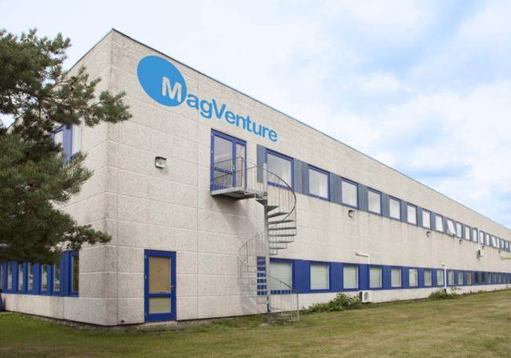
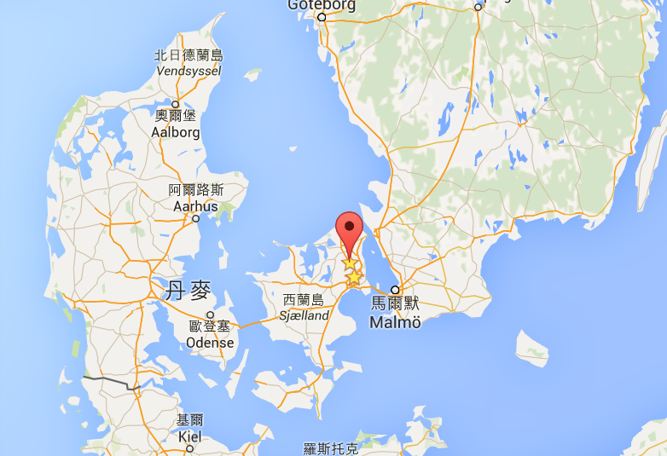
The MagPro product line was first introduced in 1992 by MagVenture's sister company Tonica Elektronik
MagVenture A/S Lucernemarken 15
DK-3520 Farum Denmark
Phone: +45 4499 8444
Fax: +45 4439 0449

Slide 3
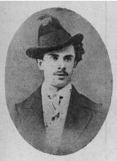
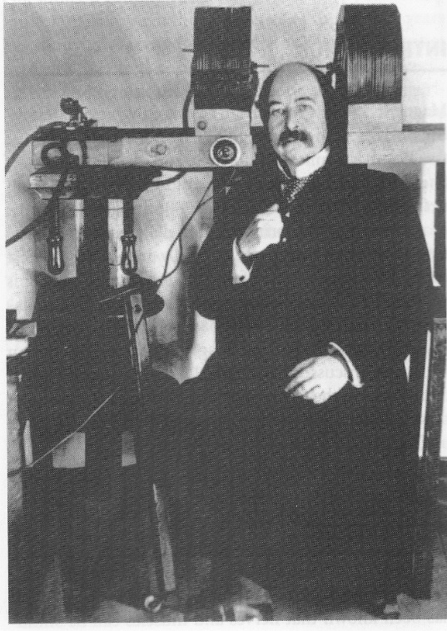
History of Magnetic Stimulation
1896 Arsenne d‘Arsonval: used high power coils and showed that magnetic pulses induces phosphenes into human cortex
Silvanus P. Thompson: reproduced the results of d‘Arsonval
1985 Anthony Barker: First magnetic stimulator for clinical usage

Slide 4
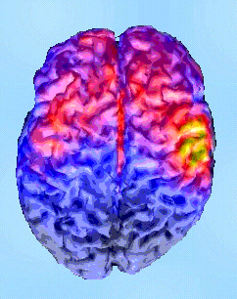
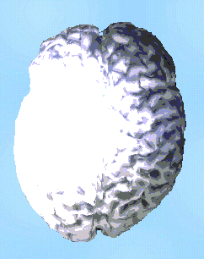
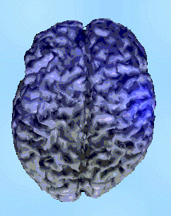
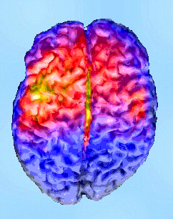
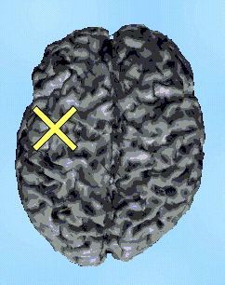
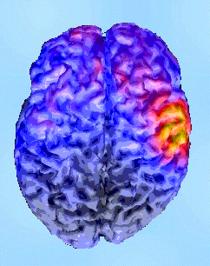
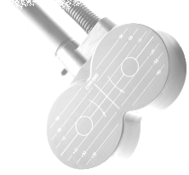
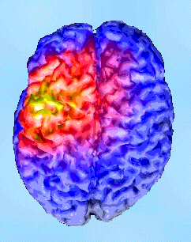
Magnetic Stimulation
The first work of transcranial magnetoelectric stimulation (TMS) was puplished by Barker et al. in 1985
Since then, the technique of magnetic stimulation (MS) has been used in the study of both the central and the peripheral nervous system (Motor Evoked Potentials)
and starts to be used in therapy as a new treatment for major depressive disorder
(Repetitive Transcranial Magnetic Stimulation), and as an alternative to electroconvulsive therapy.
BioMag Laboratory
Helsinki University Central Hospital
with permission

Slide 5
Basics in Magnetic Stimulation
What is Magnetic Stimulation
How does it works?
Parameters
Safety regulations
MagPro-Family
Coil portfolio
Accessories

Slide 6
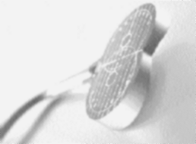
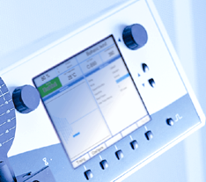
A Magnetic Stimulator consists of two elements:
The “POWER Generator” - MagPro
The COIL which transfers the energy into the tissue
Different types of “power generators” are available for different applications.
Wide range of Coils for specific stimulations: Circular or 8, high or low focal, flat, parabolic or shaped, static or dynamic cooling.

Slide 7
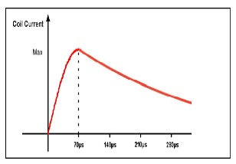
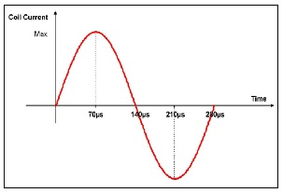
Magnetic Stimulation
Charging Circuit
Trigger
Output
Circuit
Current I :
Monophasic Biphasic
Thyristor
B
I
Power
Supply
V
Tank
Capacitor
C
COIL
Capacitor is charged to 300 Joules (½ CV²)
Induced
EMF. Field
Pulse triggers the thyristor
Thyristor discharges capacitor through the Coil
Which generates a magnetic field B (≈ 4 Tesla) and induces EMF field up to 50 KT/s

Slide 8
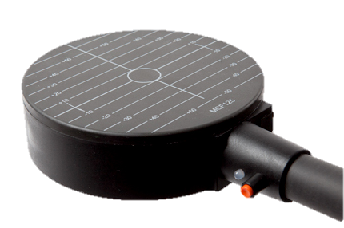
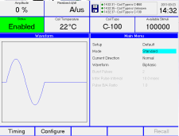
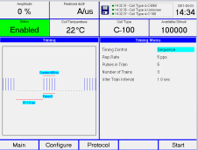
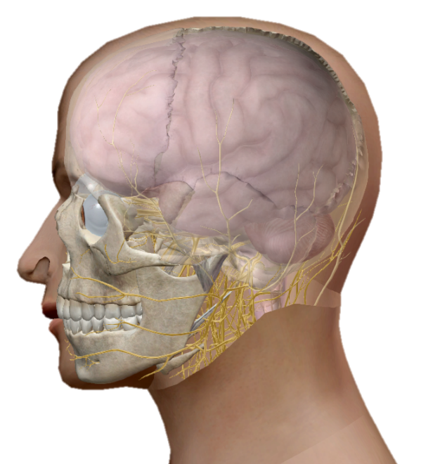
Principle Functioning
Charging Circuit
continous charging of
tank capacitor (300 J)
Stimulation Circuit
Release of pulses based
on programed features
altered/pulsed coil current produces an altered/pulsed magnetic field.
This M-Field induces a counter running pulsed/altered E-Field
Power Generator
Coil

Slide 9
Induced EMF Field
Depends on the geometry of the Coil
Electric Field can be expressed in
V/m (≈ 100 V/m)
V/mm² (≈ 50mV/mm²)
kT/s (≈ 50 KT/s)
3.1T
Initial Magnetic Gradient
(at surface of the coil)
3.1 / 70 • 10⁻⁶ ≈ 44,300 T/s 44.3 kT/s
Total Magnetic Gradient (Biphasic)
|3.1 x 2| / 140 • 10⁻⁶ ≈ 44.3 kT/s
70µs

Slide 10
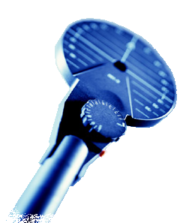
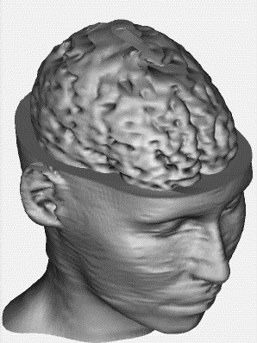
Monophasic or Biphasic Stimulus?
Clockwise positioned
Monophasic stimulus
Clockwise positioned,
induced current in tissue flows counterclockwise.
This preferentially activates right hemisphere,
i.e. left limb muscles,
and vice versa.
Biphasic stimulus
A biphasic stimulus does not show such preferential activation of either left or right hemisphere.
A biphasic stimulus generates a higher magnetic field B.

Slide 11
Parameter
Intensity: Power provided by tank capacitor
Frequency: Pulses per second
Pulse type: mono-, biphasic, halfsine,
dI/dt: released current per pulse, sent through the coil
ISI/IPI: Inter Stimulus/Pulse Interval: time between the stimuli/pulses
ITI: Inter Train Interval: time between the trains (pause)
Burst: Pulses bundled to one stimuli
Twin: paired pulses, Pulse B in relation to Pulse A
Dual: paired pulses, Pulse A and B independent
MT: Motor Threshold
Train: No. of stimuli released with a dedicated frequency
Stimuli: defined pulse

Slide 12
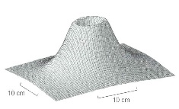
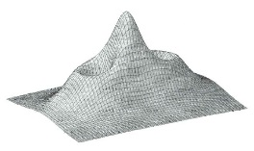
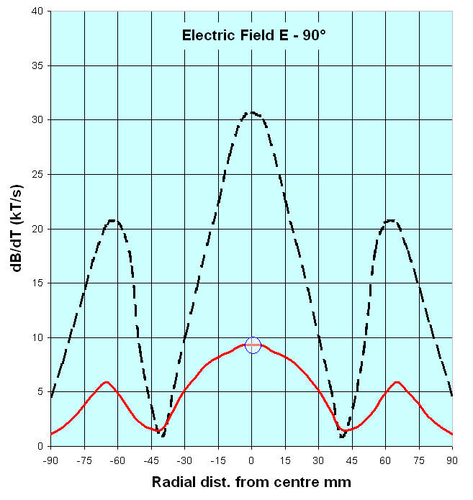
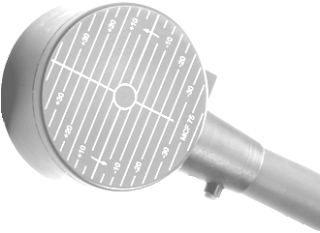
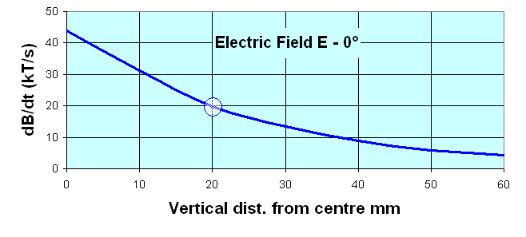
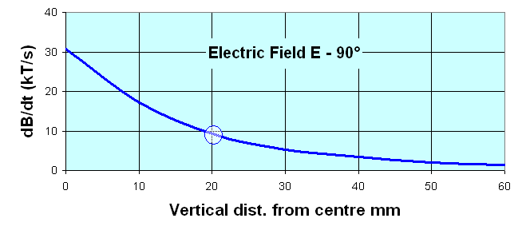
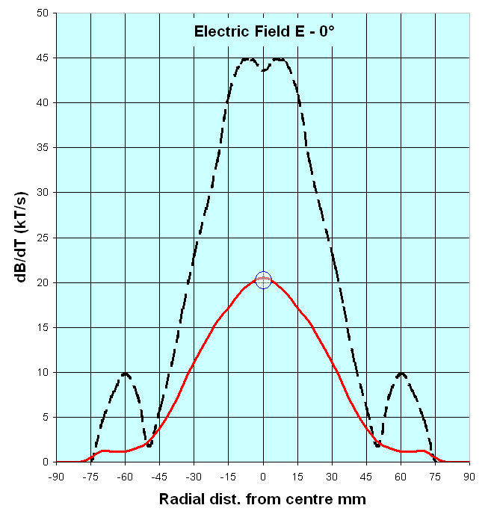
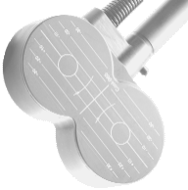
Coils
Power and focal of stimulation depend
on the geometry of the coil
Circular
Butterfly
The intensity of the electric field decrease with the square of the distance
With a Circular Coil, the electric field E is parallel to the plane of the coil.
Lines of E follow the shape of the coil.
With a Butterfly Coil, the electric field E is perpendicular to the plane of the coil and located under its centre.
Magnetic Field B
Coil
Electric Field E

Slide 13
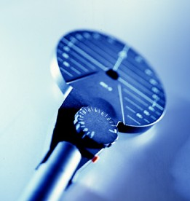
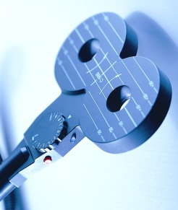
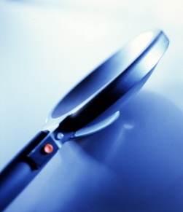
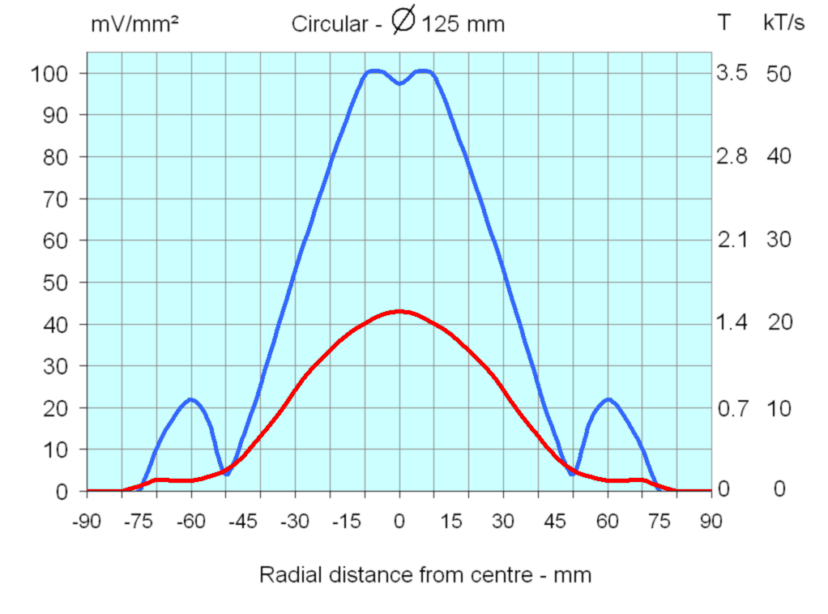
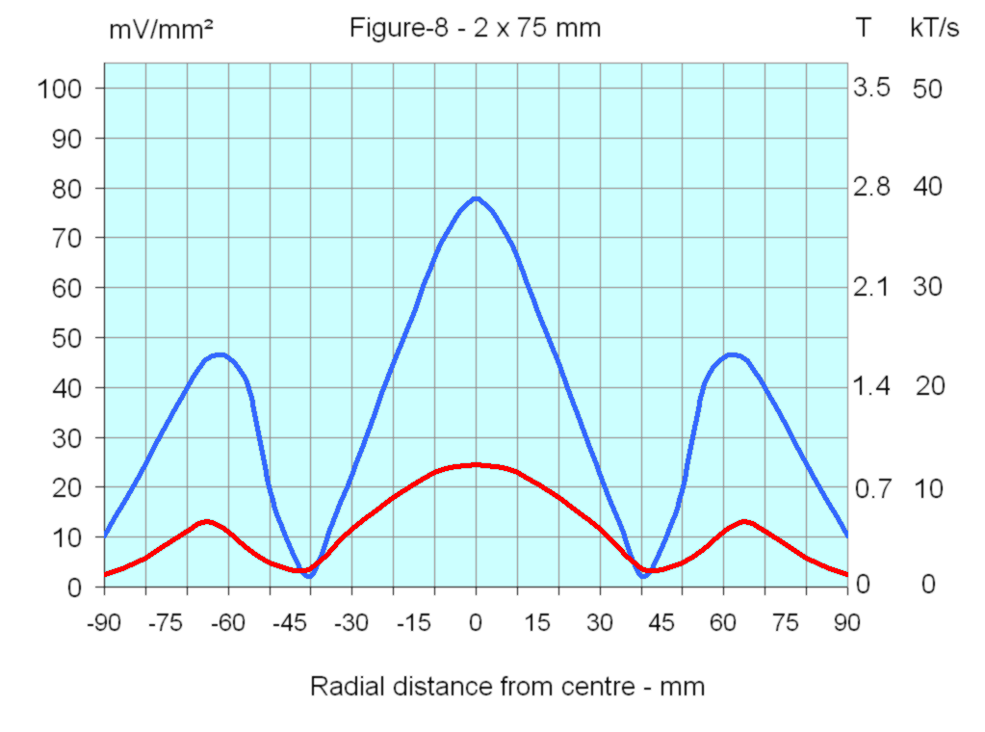
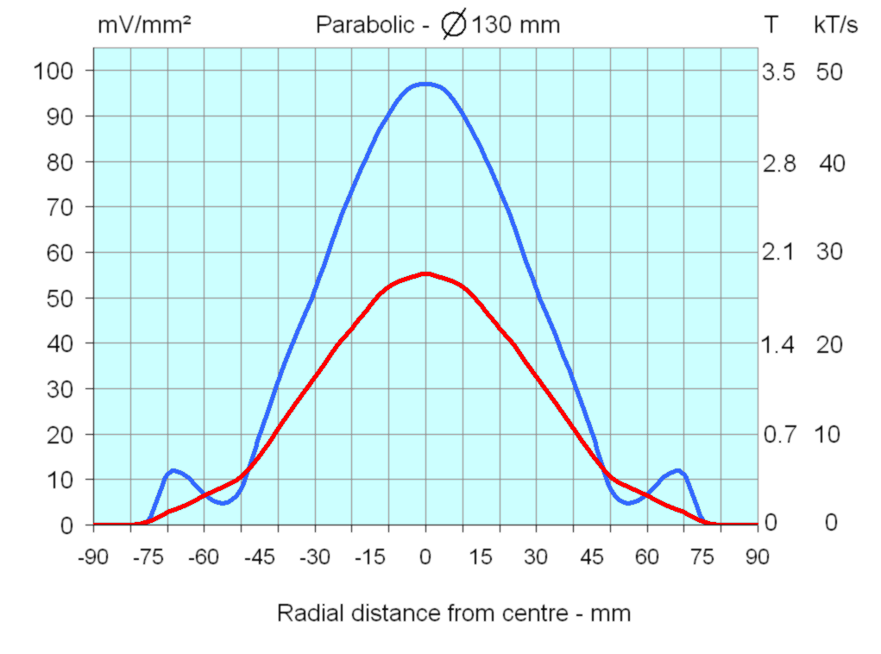
Coil Performance
Circular
Figure-8
(Butterfly)
Parabolic
At the surface of the coil
At 2 cm depth

Slide 14
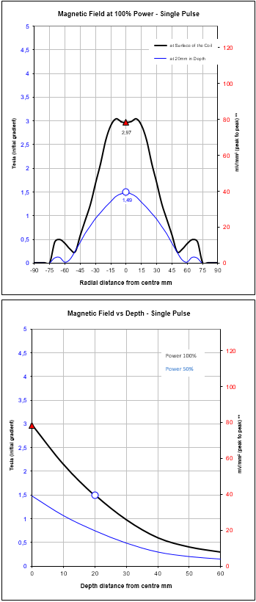
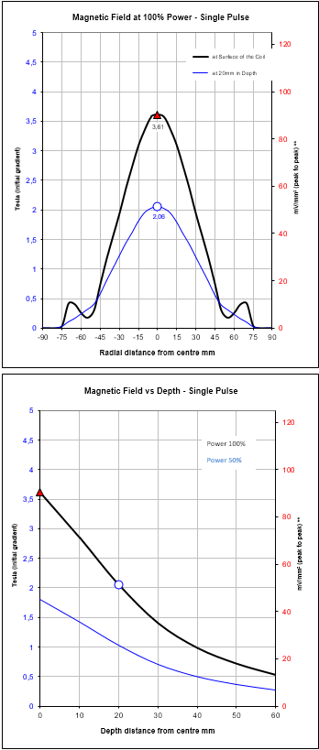
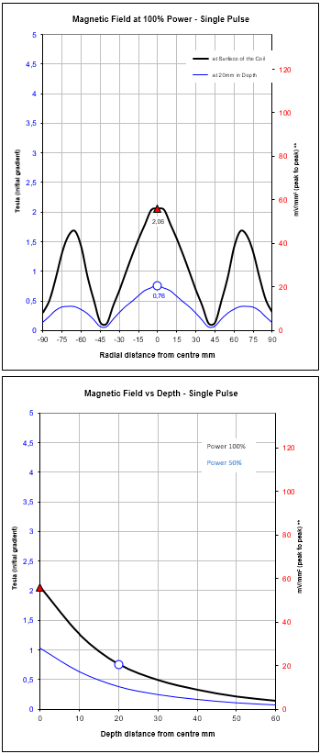
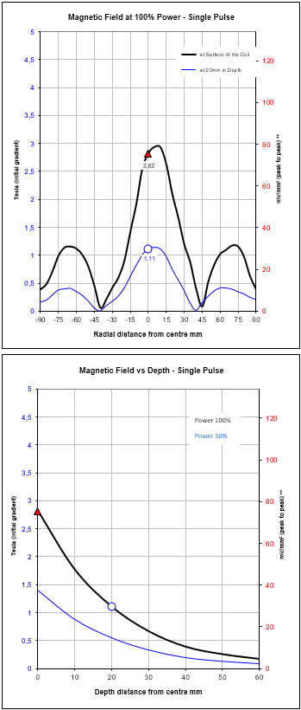
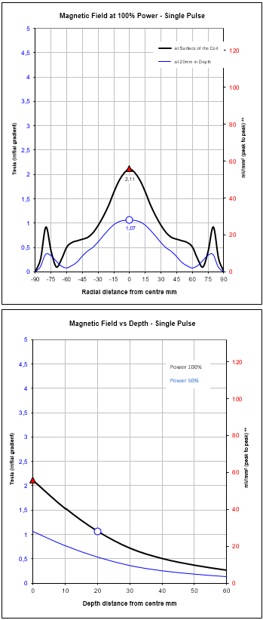
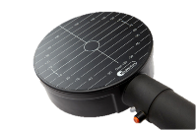
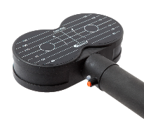
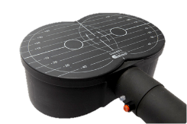
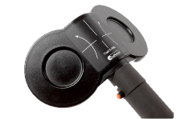
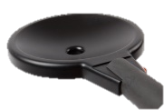
Coil Performance - Comparison

Slide 15
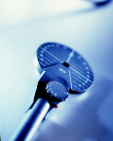
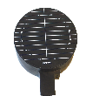
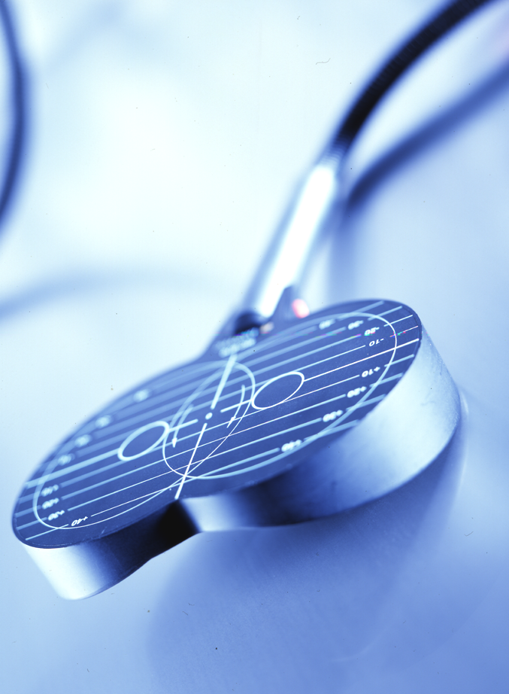
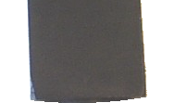







Choice of Stimulating Coil
A B C
A coil warm-up with power and frequency rate of stimulation
Different coils will be used for:
single stimulation MEP - Cortical Excitability - Rehabilitation
low stressed stimulation Train of stimuli at 1pps (Static Fluid)
high stressed stimulation Train of stimuli at 10pps (Dynamic Fluid)

Slide 16




Coil Orientation
Importance of the coil orientation with the figure-8 coil (butterfly).
Depending on the type of the coil, 45° orientation gives the highest response.
Roots

Slide 17




Induced Current → Neuronal Depolarization
E
At ≈ 2cm in depth
Induced current ≈ 15-20 mA/µs
Electric field E:
50-60 V/m
10-20 mV/mm²
10-20 kT/s
Intracranial Field
E

Slide 18




Waveform and Induced Electric Field
Biphasic
Typically chosen where high energy is needed with low power.
Application: MEP, rTMS and fMS
Monophasic
Used in brain research.
A large amount of energy is lost in the coil, which explains the faster heating of the coil and limits the number of stimulation.
Half Sine
Used in brain research.
Half sine waveform requires a small amount of energy compared with monophasic.
Biphasic Burst
Adjustable burst up to 5 pulses with selectable inter-peak interval.
Application: Theta-burst stimulation in long-term potentiation (LTP).

Slide 19

Power Mode (+40%)
The power mode principle is to increase the duration of the pulse wave by adding capacitor of the MagOption unit. This results in increasing the quantity of energy by around 40%.
The benefit of this mode is to reduce the level of motor threshold versus the power output of the stimulator, expressed in true A/µs or by default in %.

Slide 20


Paired-Pulses (Twin and Dual Mode w/ MagOption)
The Twin-pulse and Dual-pulse modes (also called paired-pulses) are techniques that use double magnetic stimulator. This is realized by using the “MagOption” unit. Two pulses are sent during the same shoot.
The delay between the two pulses (IPI) is adjustable up to 3,000ms.
In Dual mode two pulses have an independent power adjustment, up to 100%.
In Twin mode the second pulse is set as a ration of the first pulse (0.1 – 10)
Available waveforms in Twin and Dual modes: Biphasic, Monophasic and Half sine, depends on the MagPro model.
Applications:
Studies of the cortical excitability and plasticity.
The first pulse can activate both inhibitory and facilitator mechanisms, as well as modify the threshold and readiness of the second pulse.

Slide 21
Coil’s Wirings (Small Inner Diameter)
Circular Coil
Parabolic Coil
Superimposed
Butterfly Coil
Butterfly Coil
Due to the complexity of multiple coils,
the magnetic gradient δB/δt is measured in 3 axis.

Slide 22
Coil Focalization
Circular
Butterfly
Bulky windings with a large inner diameter
Windings
Peak Electric Field Strength
Radial Displacement from Centre, Parallel to the Coil Surface.
Flat windings with a small inner diameter
Windings

Slide 23


Coil performance (with biphasic pulse)
Induced electric field
(100% Output Power)
Blue curve: measurements at the surface of the coil.
Red curve: measurements at 20mm in depth.

Slide 24



Cool-Coil performance (with biphasic pulse)
Induced electric field (100% Output Power)
± 3cm
Radial Distance
Blue: Surface of the coil
Red: 2cm above the coil
Vertical Distance

Slide 25


Cool-Coil performance (with biphasic pulse)
Continuous stimulation
(Extrapolation)
Sound Level at 10pps

Slide 26







Magnetic Radiation
The magnetic field at one point is inversely proportional to the square of its distance from the coil.

Slide 27



MagPro Family

Slide 28





MagPro Family
MagPro Compact
MagPro R30
MagPro X100 with M.O
MagPro R100
MagPro R20

Slide 29


MagPro Family - Routine
MagPro R20
stimulation frequency 1-20 Hz
biphasic waveform
documentation and report via WiFi
standard and static cooled coils
MagPro R30
stimulation frequency 0.1-30 Hz (80 Hz*)
biphasic waveform, (ThetaBurstStimulation*)
documentation and report via MS Excel*)
standard, static cooled and continuous cooled coils
upgradeable for advanced science
MagPro X100
stimulation frequency 0.1-100 Hz (250 Hz*)
biphasic/monophasic waveform, burst
documentation and report via MS Excel*)
standard, static cooled and continuous cooled coils
upgradeable for advanced science
* Optional items or packages, installable onsite

Slide 30
MagPro Family - Research
MagPro X100 MO
stimulation frequency 0.1-100 Hz (250 Hz*)
biphasic/monophasic waveform, burst
paired pulses, half sine, Powerpulses
Paired pulse composer*)
Study-Mode for double blinded studies*)
documentation and report via MS Excel*)
standard, static cooled and continuous cooled coils
etc.
MagPro R30 MO
stimulation frequency 0.1-30 Hz
biphasic/monophasic waveform
paired pulses
Study-Mode for double blinded studies*)
documentation and report via MS Excel*)
standard, static cooled and continuous cooled coils
etc.
* Optional items or packages, installable onsite

